Slide 1
Pandas Package

Slide 2
Overview
Powerful python Library to provide data analysis features
It is built on top of NumPy
It’s an open-source product.
Key components provided by Pandas:
Series
DataFrame

Slide 3
Install Pandas
pip install pandas
import pandas as pd

Slide 4
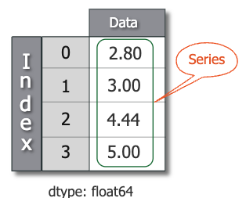
Series
One of the most important data structure in pandas
One dimensional array-like object
It contains array of data with associated indexes. (Indexes can be strings or integers or other data types.)
By default , the series will get indexing from 0 to N where N = size -1

Slide 5
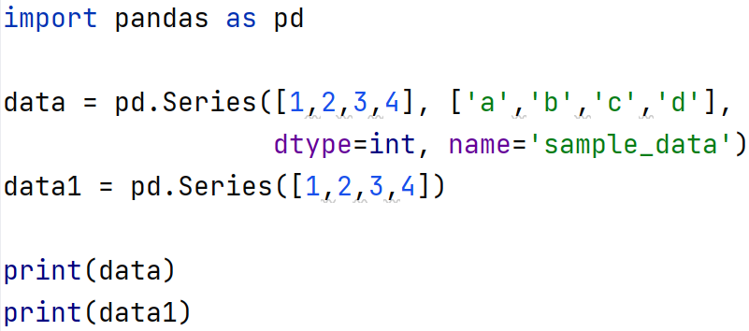
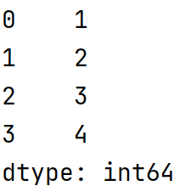
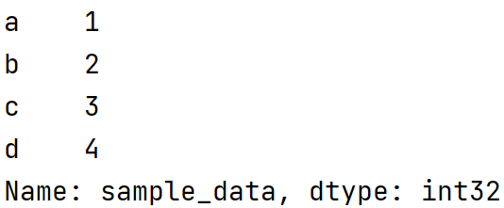
Creating Series
pandas.Series(data=None, index=None, dtype=None, name=None)

Slide 6
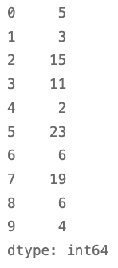
Indexing and slicing in Series
The same as numpy array, we can search data in series with specific index
series_data[0] extract the first element
series_data[:3] extract the first three elements
series_data[3:9] extract elments from index 3 to index 9

Slide 7
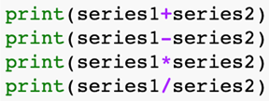
Mathematic operation in Pandas Series

Slide 8
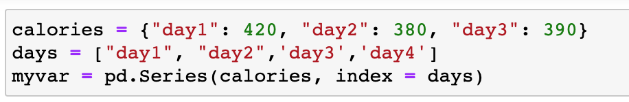
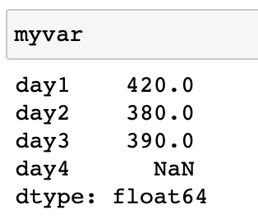
Null value in Pandas Series
Null value is a missing data in panda series, and it is denoted by NaN

Slide 9
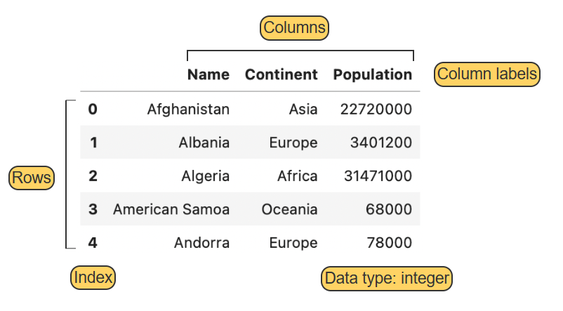
DataFrame
Pandas represents datasets with the DataFrame type
A dataframe consists of rows and columns (instances and features)

Slide 10
DataFrame
Rows and columns are identified by integer or string labels.
The set of row labels: index
The set of column labels: columns
All values in a column must have the same type
Different columns may have different types
Commonly used data types - integer, float, or string.

Slide 11
Pandas Dataframe vs. NumPy array
Similarity:
Both are indexed, ordered, and mutable containers.
Both represent data in multiple dimensions.
Difference
Dataframes are always two-dimensional. Arrays may have zero, one, or many dimensions.
Different dataframe columns may have different types. All numpy array values have the same type.
Dataframe labels may be integers, strings, or other types. Array indexes are integers only.

Slide 12
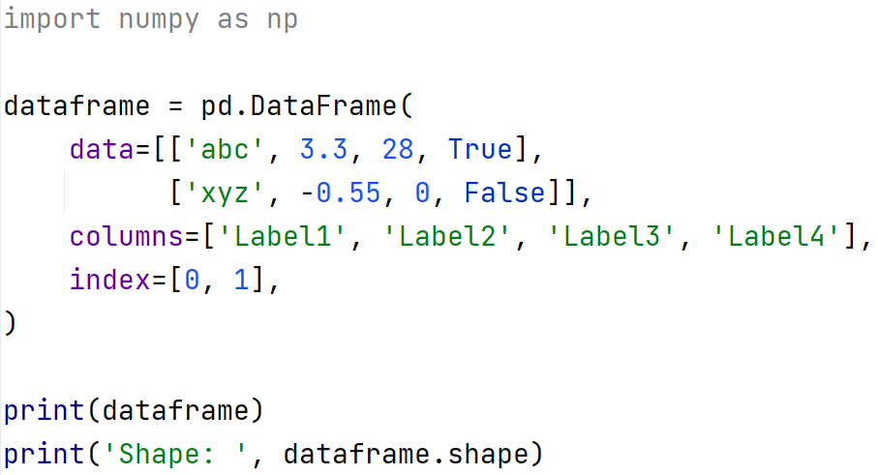
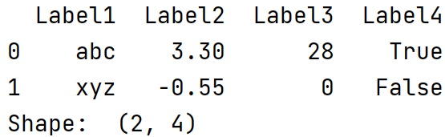
Creating and printing a DataFrame object

Slide 13
Subsetting Data
Subsetting data involves choosing specific rows and columns from a dataframe
A single column can be selected by using the label of the desired column. E.g. country[‘Population’] or country.Population
Multiple columns can also be selected by using an array of strings. E.g. country[[‘Name’,’Population’]]

Slide 14
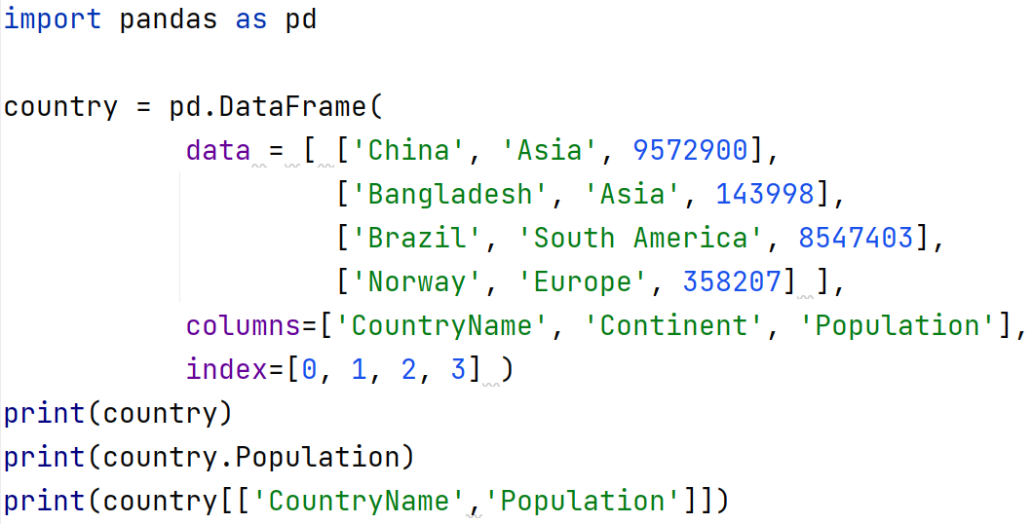
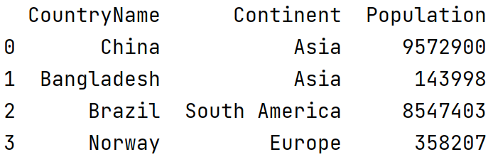
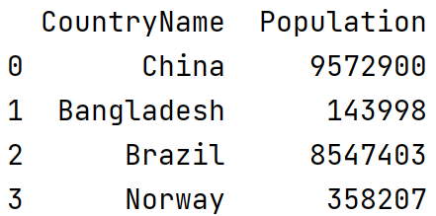
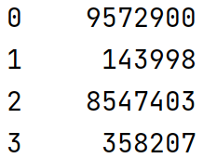

Slide 15
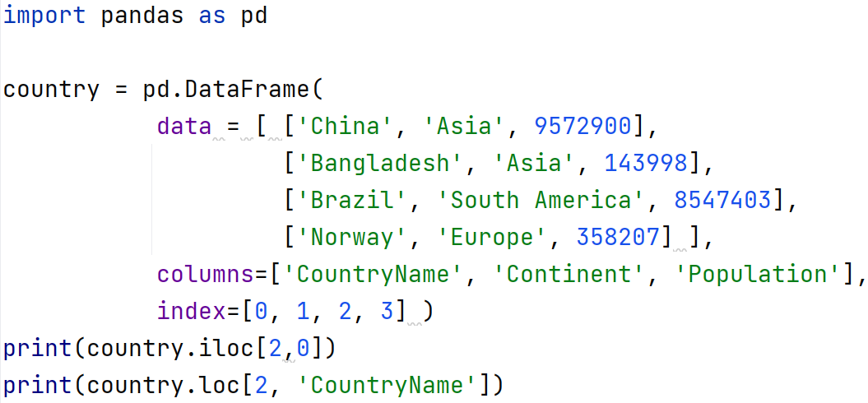

Selecting individual element
iloc(x,y) where x = row index & y = column index
loc(x,y) where x = row index & y = column label

Slide 16

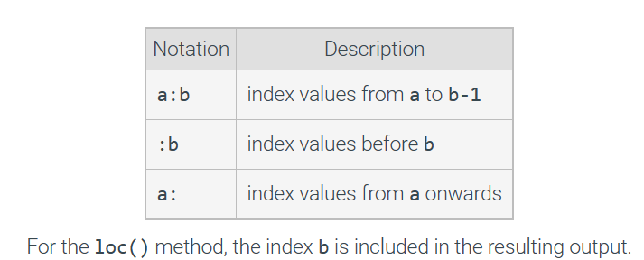
Slicing

Slide 17
Slicing Practice
0 1 2 3 4
0
1
2
3
4
5
6
Slice 1: country.iloc[:5,:3]
Slice 2: country.iloc[3:5,:3]
Slice 3: country.iloc[3:5,1:3]
Slice 4: country.iloc[5:,3:]
Country

Slide 18
Choose all columns of all the rows from 4 to end
data.iloc[???,???]
Choose the last 2 colymns from all rows:
data.iloc[???,???]

Slide 19
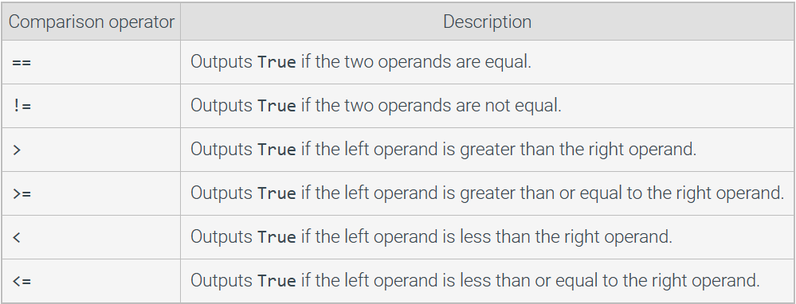

Subsetting data using comparison and logical operator

Slide 20
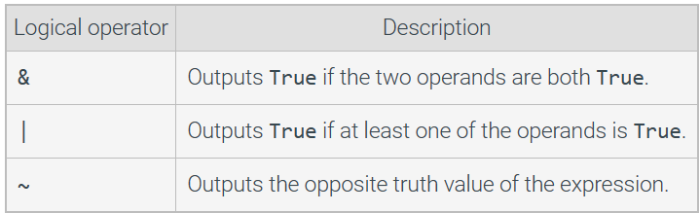


Slide 21
country.csv
 | CountryName | Continent | Area | Population | Density | Independence | Language | Percentage
0 | China | Asia | 9572900 | 1277558000 | 133 | 1949-10-01 | Mandarin | 0.81
1 | Bangladesh | Asia | 143998 | 129155000 | 897 | 1905-05-24 | Bengali | 0.98
2 | Brazil | South America | 8547403 | 170115000 | 20 | 1822-09-07 | Portuguese | 0.98
3 | India | Asia | 3287263 | 1013662000 | 308 | 1905-04-30 | Hindi | 0.40
4 | Norway | Europe | 385207 | 5379000 | 14 | 1905-05-17 | Norwegian | 0.97
5 | United States | North America | 9363520 | 278357000 | 30 | 1776-07-04 | English | 0.86

Slide 22
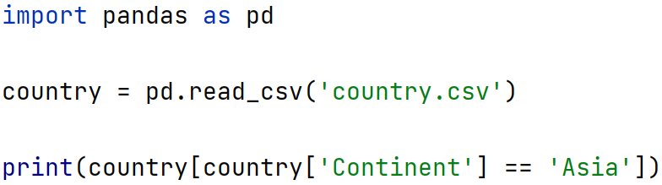
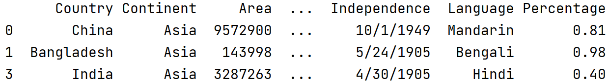
Practice Question 1
Select rows where the Continent is Asia
Select rows where the Continent is not Asia?

Slide 23
Practice Question 2
Select rows where the Continent is South America or Europe
print(country[(country['Continent'] == 'South America') | (country['Continent'] == 'Europe')])

Slide 24
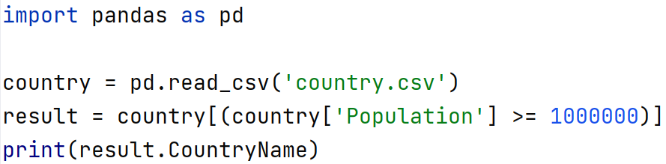
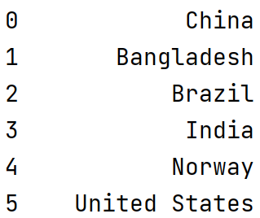
Practice Question 3
Print the name of countries with a population of at least 1 million

Slide 25
Attendance

